Slide 1




Data: debunking myths and asking more questions
The Water Rights Tracker
Dr Johandri Wright
October 2026

Slide 2

A complex function
The only public service that’s success depends on the effective delivery of other services.
Sources and manner of service delivery varies greatly from municipality to municipality.
  Geographical conditions and size
  Different raw water sources, availability and quality
  Other natural conditions such as damaging winds
All of this affects how water services can be delivered and what it would cost a municipality – tariff variance
  Cheapest tariff R 1,70 – Northern Cape
  Most expensive tariff R 179,20 – Eastern Cape

Slide 3

Tariffs and myths
There is a modest correlation between expensive tariffs and better-quality water, particularly for chemical compliance.
High unemployment levels or a large portion of the community receiving indigent benefits do not automatically impair a municipality’s ability to meet its financial obligations.
  OR Tambo – unemployment of 55,6% and dependency of 70. However revenue sufficiency is at 175%.
High unemployment and dependency levels do not automatically translate into poor quality water.
Socioeconomic pressure such as high unemployment and high dependency ratio’s do not reflect in the amount of households benefiting from indigent benefits.
  Amathole – 46,2% unemployment and dependency exceeding 65, but only 0,66% households receive FBW.

Slide 4
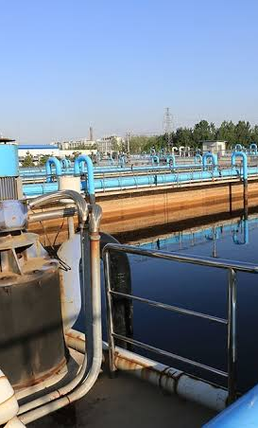
What we didn’t find
Some records did not make sense when interpreted together:
  100% yard connections, but low service point ratio.
  Good water efficiency score, but high material water losses reported by AGSA.
  Good scores on quality compliance indicators, but 0% of water treatment capacity used.
Incomplete asset registers.
No easily accessible and reliable information on water services interruptions.
No easily accessible platform to access information on interventions and oversight action by various state institutions,
Incomplete municipal records including financial information and policy instruments.

Slide 5

Why this matters?
There is a direct relationship between poor records and poor performance.
Poor or inaccurate data and records affects planning.
In some instances, it could point toward misreporting.
It highlights that data and records are maintained in isolation, and in this way important issues remain obscured.

Slide 6
THANK YOU

